Slide 1

Department of Computer Engineering
Demultiplexer
1

Slide 2
Points covered
Department of Computer Engineering
Demultiplexer
Decoder
Decoder as ROM
Examples
Quiz
2

Slide 3
Department Vision & Mission
Department of Computer Engineering
Vision
Achieve academic excellence through education in computing, to create intellectual manpower to explore professional, higher educational and social opportunities.
Mission
To impart learning by educating students with conceptual knowledge and hands on practices using modern tools, FOSS technologies and competency skills there by igniting the young minds for innovative thinking, professional expertise and research.
3

Slide 4
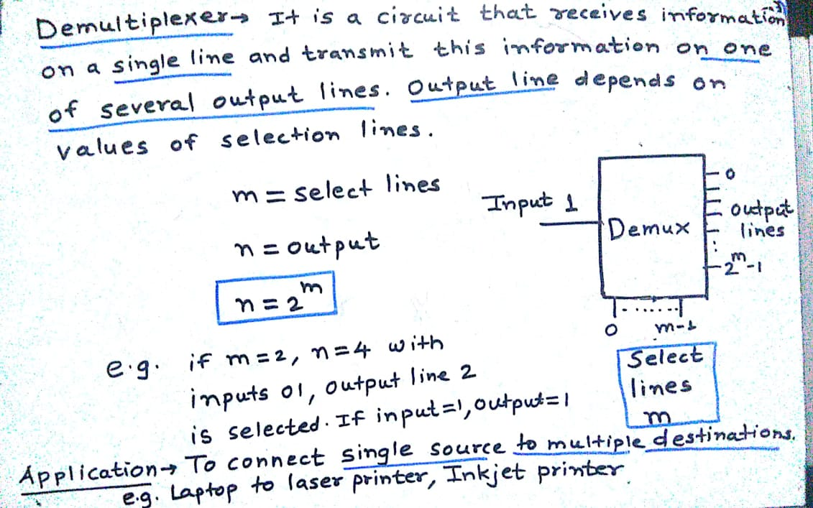

Demultiplexer
Department of Computer Engineering

Slide 5



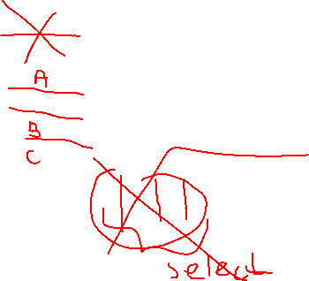
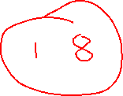


Slide 6
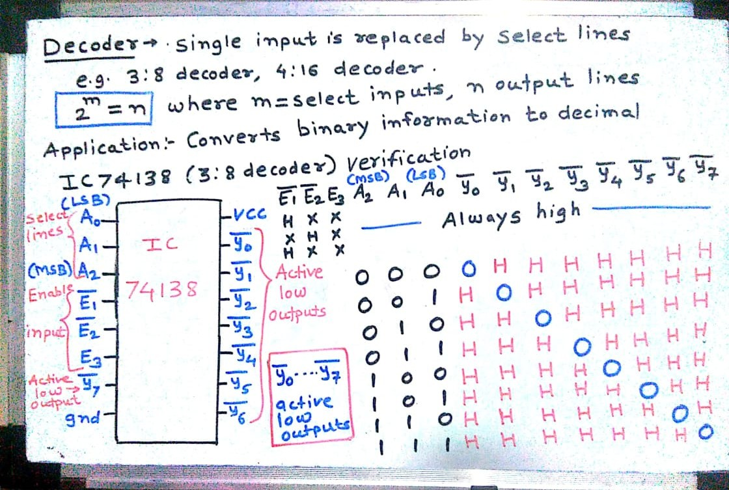


Decoder
Department of Computer Engineering

Slide 7
f(A,B,C) = Σ m (0,2,4,5)

Slide 8
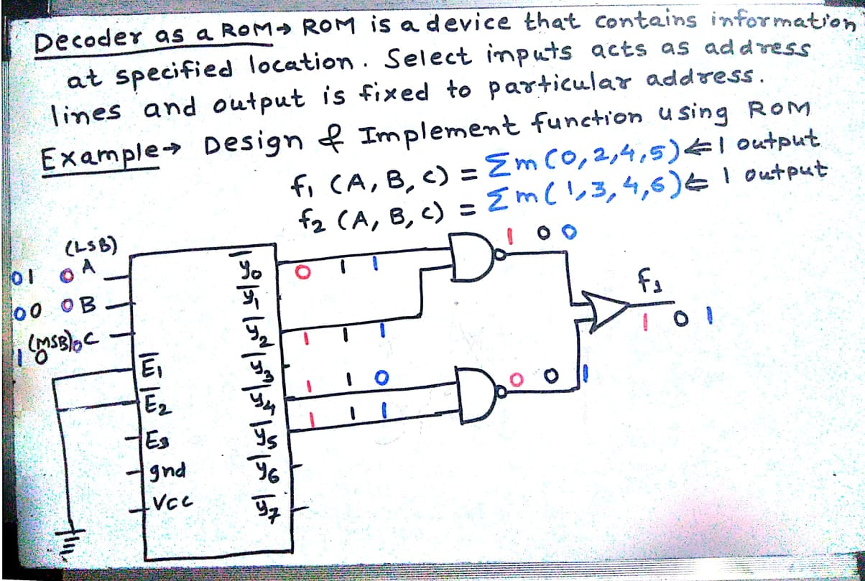




Decoder as ROM
Department of Computer Engineering

Slide 9
Design and Implement Full adder
Sum = f(A,B,C) = Σ m (1,2,4,7)
Carry= f (A,B,C) = Σ m (3,5,6,7)

Slide 10
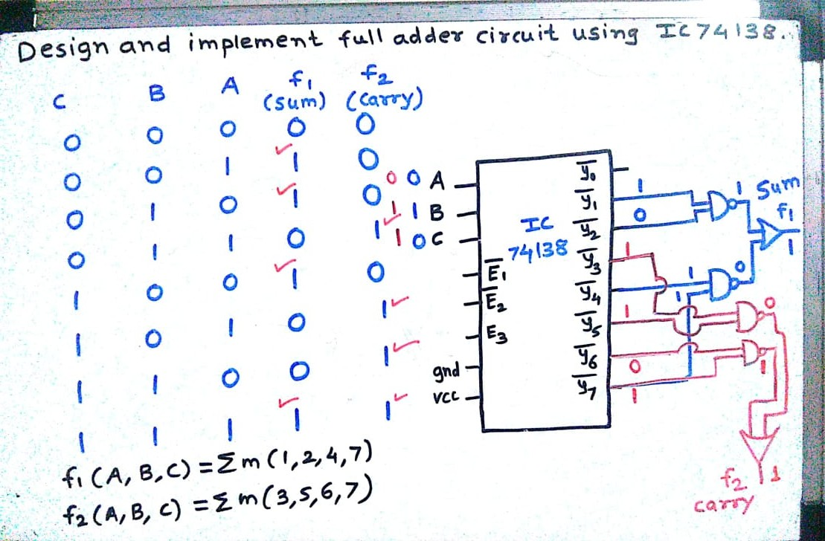







Examples
Department of Computer Engineering

Slide 11
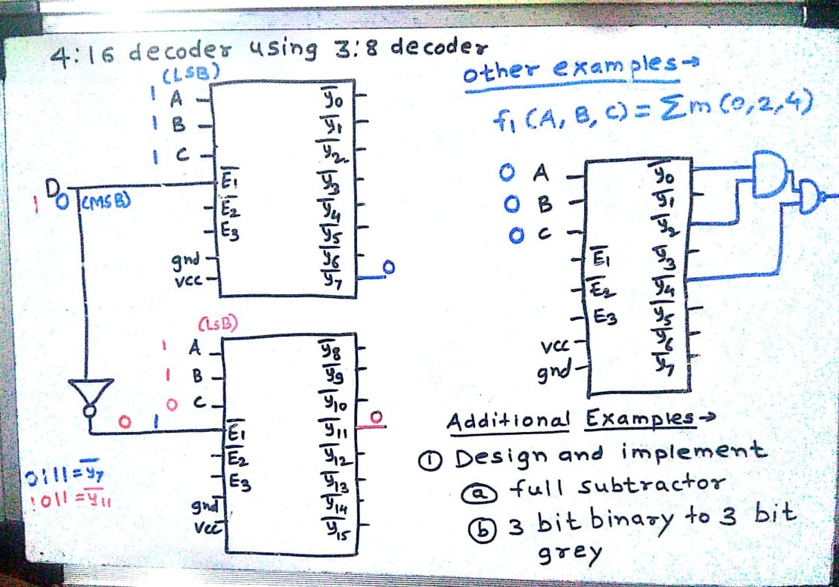






Examples
Department of Computer Engineering

Slide 12
Examples
Department of Computer Engineering

Slide 13
Quiz
Please click the following link to open the quiz
testmoz.com/4306960

Slide 14
Summary
Department of Computer Engineering
Demultiplexer
Decoder
Decoder as ROM
Example
Quiz

Slide 15
Department of Computer Engineering
Thank you

